Slide 1

Fiscal Aid for States: What’s Happened So Far and What’s Next
Michael Leachman and Wesley Tharpe
April 27, 2020
Notes:
Tax policy in the United States has never been race neutral, and is not today.
I’m really pleased to be here…..deep respect for the work of Colorado Fiscal Institute and Vision 2020 and other other organizations represented in the room.
Your work so crucial to Colorado’s future, and to the nation as a whole. Colorado is a policy leader and a bellweather in many ways. Thank you.

Slide 2
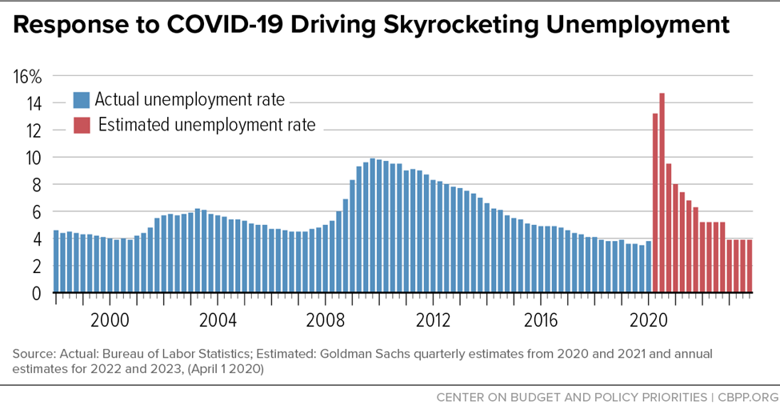

Slide 3


Slide 4
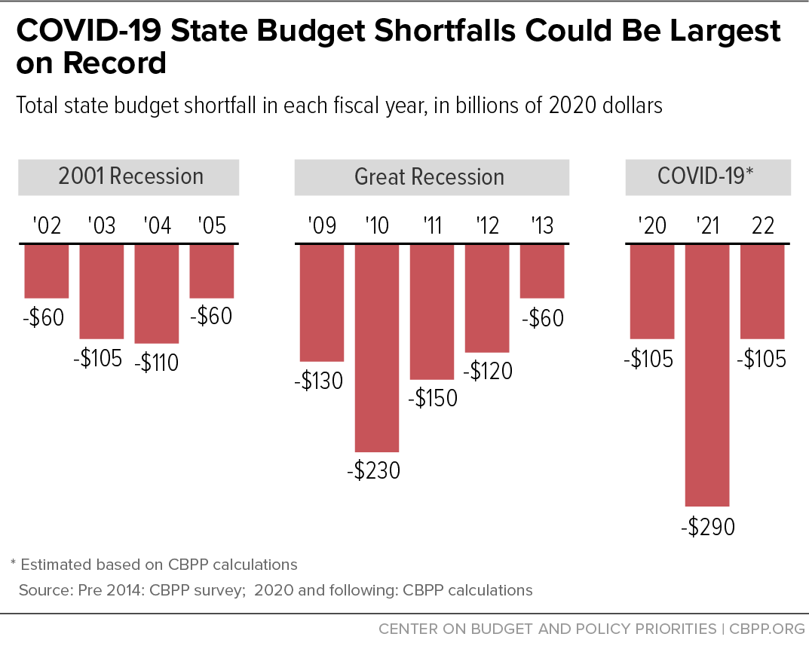
FIGURE 1

Slide 5
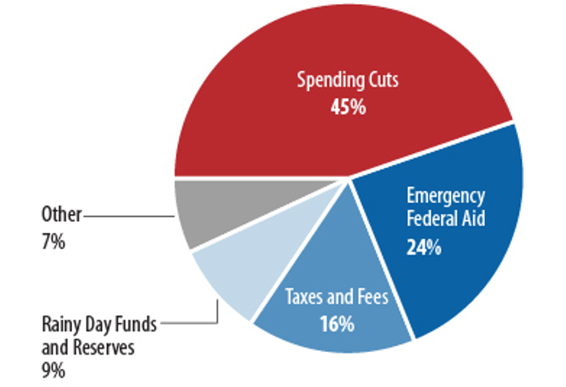
States Relied Most on Spending Cuts
During the Great Recession

Slide 6


Slide 7
FMAP increase in Families First
Increase in the share of Medicaid expenses the federal government will cover (Raises the FMAP)
Will revert to normal FMAP when the official public health emergency ends.
Worth about $35 billion if PHE lasts through end of year.

Slide 8
Coronavirus Relief Fund in CARES Act
Worth $150 billion total, distributed mostly based on population.
  $110 billion to states
  $29 billion to localities with >500k population
  $8 billion to tribes
  $3 billion to territories and DC
Treasury must release within 30 days of enactment – today!
Can’t be used for revenue shortfalls. Expecting more FAQ answers.

Slide 9
Education Stabilization Fund in CARES Act
Worth $30 billion total, distributed mostly based on Title I, Pell
  $13 billion for K12
  $14 billion for higher education institutions (50% to students)
  $3 billion for Governor to distribute to hard hit areas
US Dept of Ed has 30 days to post application process (done), and 30 days to approve or deny applications after they’re received
States must maintain their spending at FY2017-19 average

Slide 10


Slide 11
Recommendations for using fiscal relief
Prioritize the most vulnerable, make progress against racial inequities.
Work with your state’s budget experts to find the hidden pathways.
Be wary of expansive proposals for business payments, UI bailouts.
Consider payments to undocumented immigrants. May want to use General Funds.

Slide 12
State level policy response
Again, prioritize the most vulnerable, make progress against racial inequities.
Spend reserves.
Raise revenue.
  Eliminate corporate subsidies, tax breaks for the rich.
  Raise revenue – income tax rates, inheritance taxes, mansion taxes.
Free local government to raise more revenue.
Bar localities/state agencies from raising criminal legal fees/fines.

Slide 13
What’s next?
States need more relief. NGA, Cassidy/Menendez .
House proposal expected out soon.
McConnell has said no action until Senators are back in DC. Senate currently out until May 4.
McConnell blaming states for crisis.

Slide 14
CBPP recommendations for fiscal relief
Should target based on economic conditions.
Priority is automatic FMAP increase based on economic conditions.
Also should extend or expand Coronavirus Relief Fund, without restrictions on using for revenue shortfalls.
Include $ for locals but not at expense of states.

Slide 15
CBPP materials that might be helpful
State by state numbers for Coronavirus Relief Fund, Education Stabilization Fund
Paper on need for fiscal relief, with projections of how much fiscal relief needed.
Compiling new revenue forecasts.
Principles for how states can advance racial equity during crisis (coming).
Blog and paper on importance of fiscal relief for tribes.

Slide 17
Michael Leachman
leachman@cbpp.org
Wesley Tharpe
wtharpe@cbpp.org
@CenterOnBudget
www.cbpp.org
202.408.1080
Notes:
Let me close by returning to the main point: tax policy in the United States has never been race neutral, and is not today. It’s our job, collectively as state residents, to build state and local tax systems that deliberately work FOR racial equity, not against it.
I look forward to our conversation.

